Slide 1
ECG based anomaly detection using autoencoder
Presented By:
Rujuta M
KGiSL Institute Of Technology NM ID: au711721243083
3/21/2024 Annual Review
1

Slide 2


AGENDA
Problem Statement
Project Overview
Who are the end users?
Solution and its value proposition
Solution
Modelling
Results
3/21/2024 Annual Review
2

Slide 3

PROBLEM STATEMENT
ECG-Based Arrhythmias Anomaly Detection using Autoencoders. An autoencoder is a type of neural network model that attempts to learn a compact representation of the input.
Although they are an unsupervised learning method, they are technically trained using supervised learning methods, which are referred to as self-supervised.
Typically, they are trained as part of a larger model that seeks to duplicate the input.
The goal of an autoencoder is to train the network to capture the most important parts of the input image to learn a lower-dimensional representation for higher- dimensional data, typically for dimensionality reduction.
3/21/2024 Annual Review
3

Slide 4

PROJECT OVERVIEW
Objective: Develop a system for detecting anomalies in Electrocardiogram (ECG) signals using deep learning.
Approach: Employ an autoencoder neural network architecture for anomaly detection.
Goal: Provide accurate anomaly detection for early cardiac abnormality detection.
Future Directions: Further optimize model performance and integrate into clinical workflows.
Develop system for detecting anomalies in ECG signals using deep learning.
Utilize autoencoder architecture for anomaly detection.
Obtain ECG data from MIT-BIH Arrhythmia Database.
Preprocess data by filtering non-beat symbols and categorizing beats.
Extract relevant features from ECG signals for model training.
Implement autoencoder model using TensorFlow and Keras.
Train model on normal ECG signals and monitor training/validation loss.
Evaluate model performance on normal and anomalous ECG signals.
Visualize reconstruction results to identify anomalies.
3/21/2024 Annual Review
4

Slide 5

WHO ARE THE END USERS?
1. Medical Professionals:
Cardiologists, electrophysiologists, and other healthcare professionals who interpret ECGs.
Medical researchers exploring new methods for detecting cardiac abnormalities.
2. Healthcare Institutions:
Hospitals, clinics, and diagnostic centers where ECG monitoring and analysis are performed.
Healthcare organizations interested in implementing advanced AI-driven diagnostic tools.
3. Patients:
Individuals undergoing ECG testing for various reasons, such as routine check-ups, cardiac monitoring, or symptom evaluation.
Patients who may benefit from early detection of cardiac anomalies for timely intervention and treatment.
4. Healthcare Technology Providers:
Companies developing medical devices, software, and AI solutions for cardiac monitoring and diagnosis.
Technology vendors interested in integrating anomaly detection capabilities into existing healthcare systems.
5. Regulatory Bodies:
Government agencies responsible for healthcare regulation and oversight, ensuring the safety and effectiveness of medical devices and diagnostic tools.
Regulatory authorities interested in evaluating the validity and reliability of AI-based diagnostic systems for clinical use.
3/21/2024 Annual Review
5

Slide 6

YOUR SOLUTION AND ITS VALUE PROPOSITION
Data Acquisition and Preprocessing:
Each ECG signal is annotated to identify normal and abnormal beats.
Data preprocessing involves filtering out non-beat symbols and categorizing beats into normal and abnormal classes.
Feature Engineering:
Relevant features are extracted from ECG signals, including signal segments around annotated beats.
Normalization and scaling techniques are applied to prepare the data for model training.
Model Development:
An autoencoder neural network architecture is implemented using TensorFlow and Keras.The autoencoder consists of an encoder and decoder, aiming to reconstruct input ECG signals while capturing anomalies.
Training and Evaluation:
The autoencoder model is trained using normal ECG signals.
Training and validation loss are monitored to assess model performance and prevent overfitting. The trained model is evaluated on both normal and anomalous ECG signals to assess its ability to detect anomalies.
Visualization and Interpretation:
Reconstruction results are visualized for normal and anomalous ECG signals.
Anomalies are identified based on discrepancies between input signals and their reconstructed counterparts.
Performance metrics such as precision, recall, and accuracy may be calculated to evaluate the model's effectiveness.
3/21/2024 Annual Review
6

Slide 7
YOUR SOLUTION AND ITS VALUE PROPOSITION
Early Anomaly Detection:
The project offers a solution for early detection of anomalies in ECG signals, providing healthcare professionals with timely insights into potential cardiac abnormalities.
Improved Diagnostic Accuracy:
By leveraging deep learning techniques and autoencoder architecture, the project enhances the accuracy of anomaly detection compared to traditional methods, reducing the risk of false positives and negatives.
Efficient Healthcare Workflow:
Healthcare institutions can benefit from a streamlined workflow with automated anomaly detection, enabling faster interpretation of ECG results and facilitating prompt patient management decisions.
Personalized Patient Care:
The project enables personalized patient care by identifying individual cardiac anomalies based on ECG signal characteristics, allowing for tailored treatment plans and interventions.
Enhanced Healthcare Outcomes:
With early detection of cardiac abnormalities, patients can receive timely medical interventions and
preventive measures, leading to improved healthcare outcomes and potentially saving lives.
Research and Development Advancements:
The project contributes to advancements in medical research and development by exploring innovative approaches for cardiac anomaly detection, paving the way for future enhancements in diagnostic technologies.

Slide 8

THE WOW IN YOUR SOLUTION
Advanced Technology: By leveraging deep learning techniques and autoencoder architecture, the project represents a significant advancement in cardiac anomaly detection, surpassing traditional methods and opening new possibilities for improved diagnostic accuracy.
Timely Intervention: The project enables early detection of cardiac abnormalities, allowing healthcare professionals to intervene promptly and provide timely medical treatments or preventive measures, potentially saving lives and improving patient outcomes.
Personalized Care: Through the identification of individual cardiac anomalies based on ECG signal characteristics, the project facilitates personalized patient care, tailoring treatment plans and interventions to each patient's specific needs and conditions.
3/21/2024 Annual Review
8

Slide 9
THE WOW IN YOUR SOLUTION
Efficiency and Automation: The automated anomaly detection process streamlines healthcare workflows, reducing the burden on healthcare professionals and enabling faster interpretation of ECG results, leading to more efficient patient management and decision-making.
Innovation and Research Impact: The project contributes to innovation in medical research and development, pushing the boundaries of what is possible in cardiac anomaly detection and paving the way for future advancements in diagnostic technologies.
Market Leadership: By offering state-of-the-art AI-driven solutions for cardiac anomaly
detection, the project positions healthcare technology providers as leaders in the
market, setting new standards for diagnostic excellence and competitiveness.

Slide 10
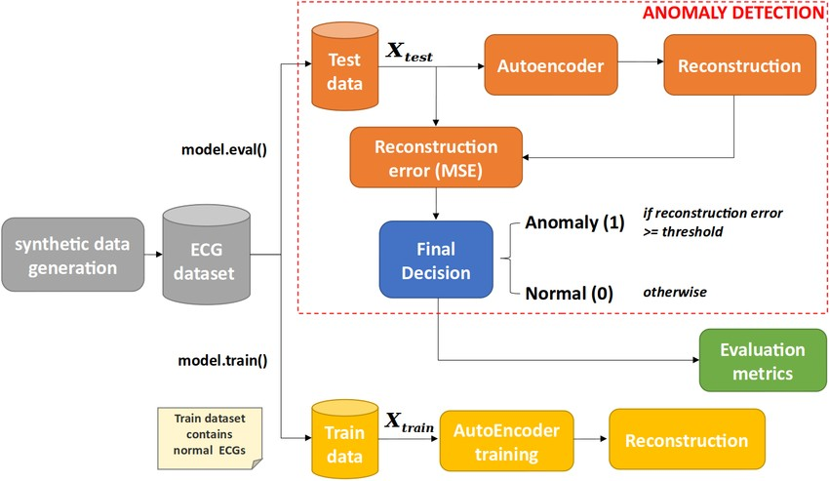
MODELLING
3/21/2024 An ual Review
10
n

Slide 11
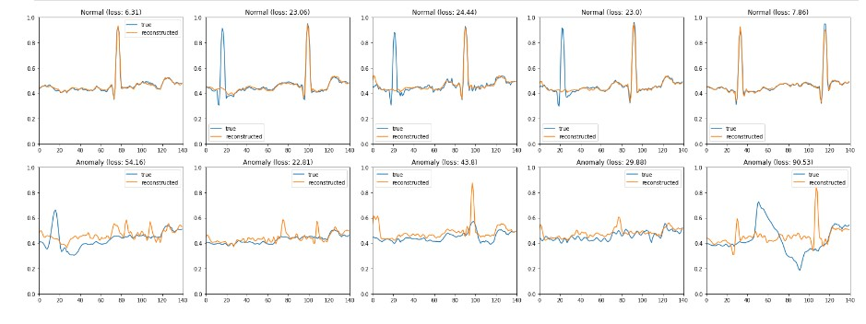
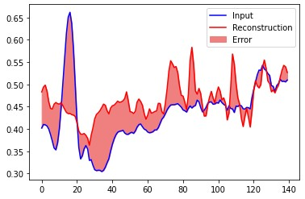
RESULTS
11

